Slide 1

Welcome to the Risk Suite on-line tutorial.
Use the down arrow to advance the tutorial.
You will receive a notification e-mail advising you of your userid and password. You must change your password as soon as possible.
To log onto the system use the following URL, http://ukdunapp003/symbiantrisksuite/LoginPage.aspx. This will take you to the log on screen as follows.

Slide 2
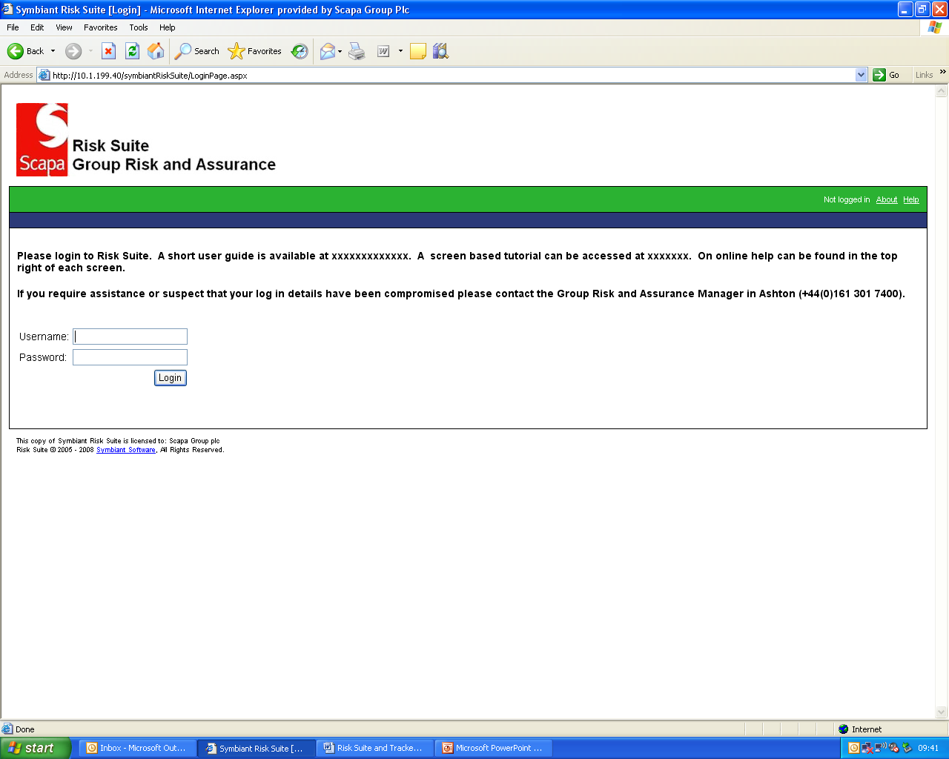
A Help facility is available on each screen.
A short user guide is also available.
Enter your userid and password, then select “Login”

Slide 3
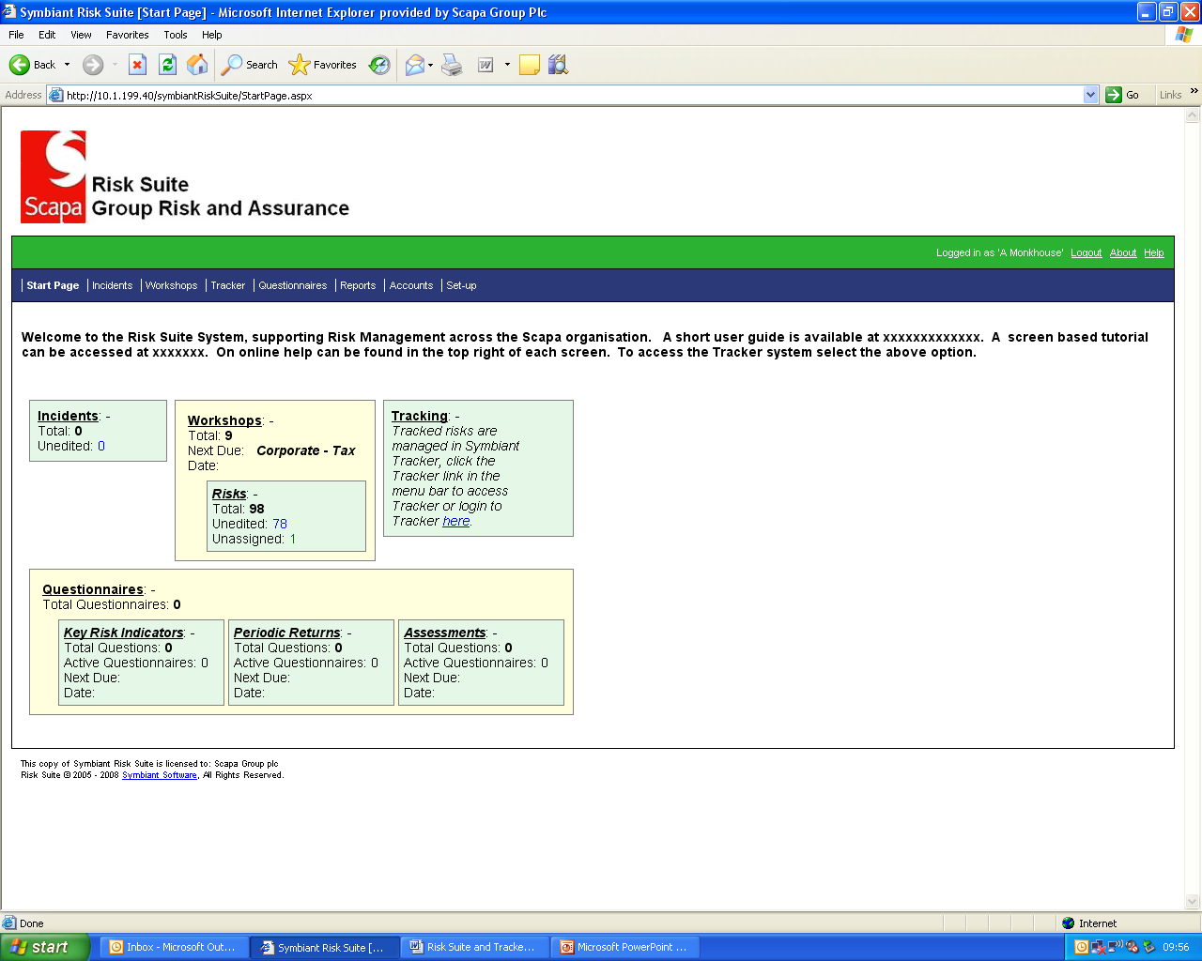
To change your password select “Account”.

Slide 4
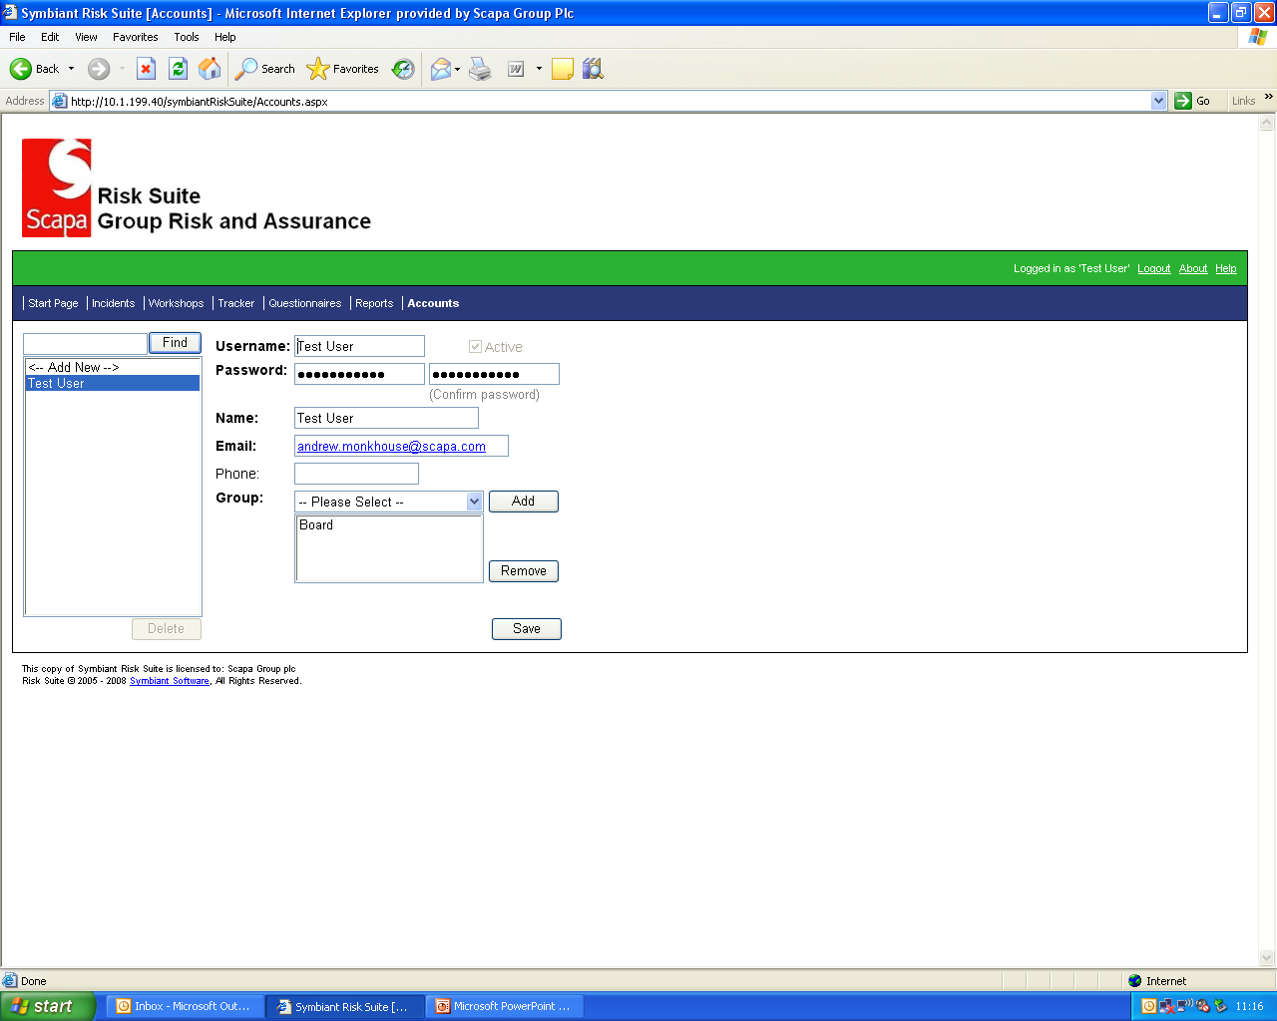
Then select “Workshops” to access the summary screen.
Enter your new password, reconfirm and “Save”.
Select your name.

Slide 5
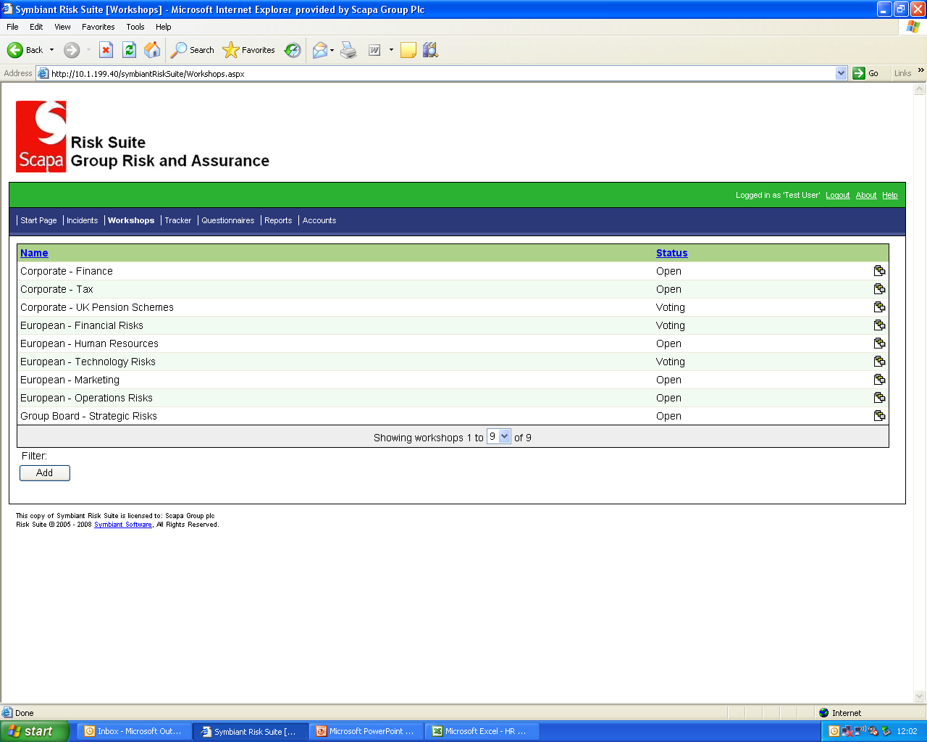
To access a summary of the risks in a Workshop, click on this icon..
This screen lists the individual risk libraries known as Workshops.
You can apply a filter to the Workshops displayed. This is pick list driven.

Slide 6
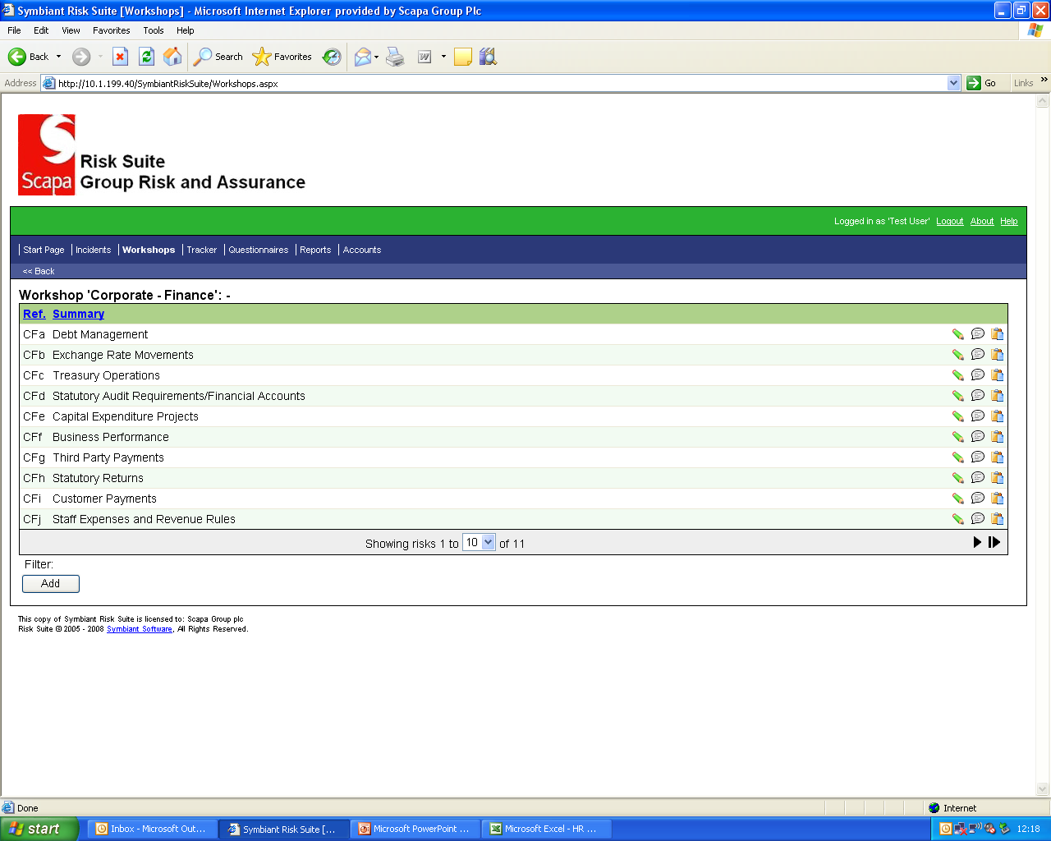
By clicking on a risk, the system will report a summary version of the risk information as follows.

Slide 7
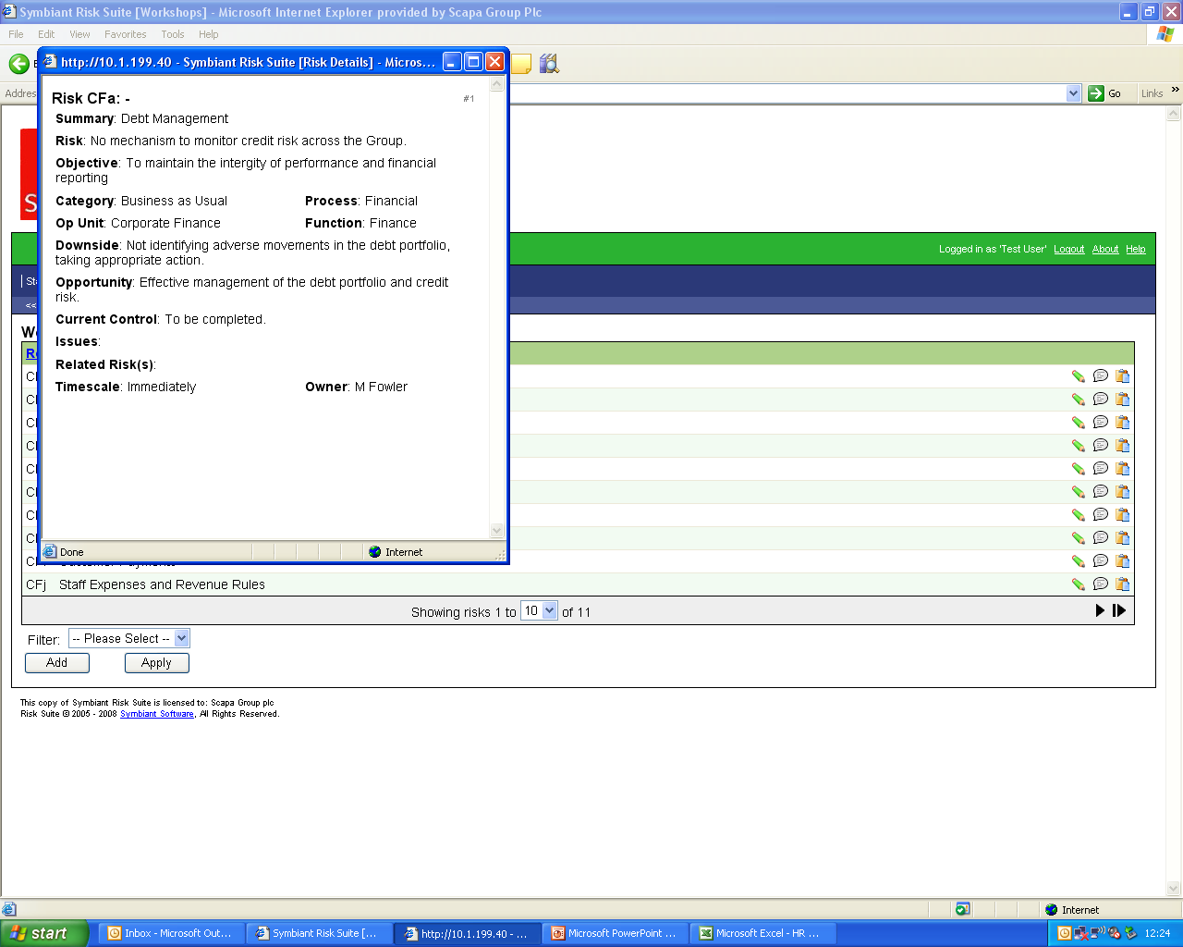
Click here to close the window.

Slide 8
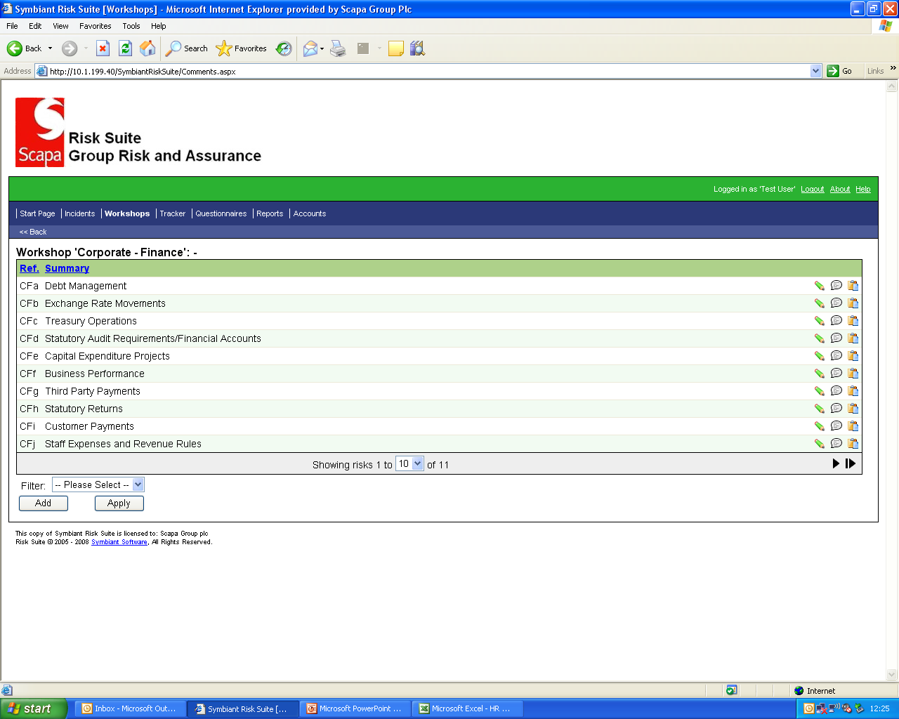
To access and edit a risk select the pencil icon.

Slide 9
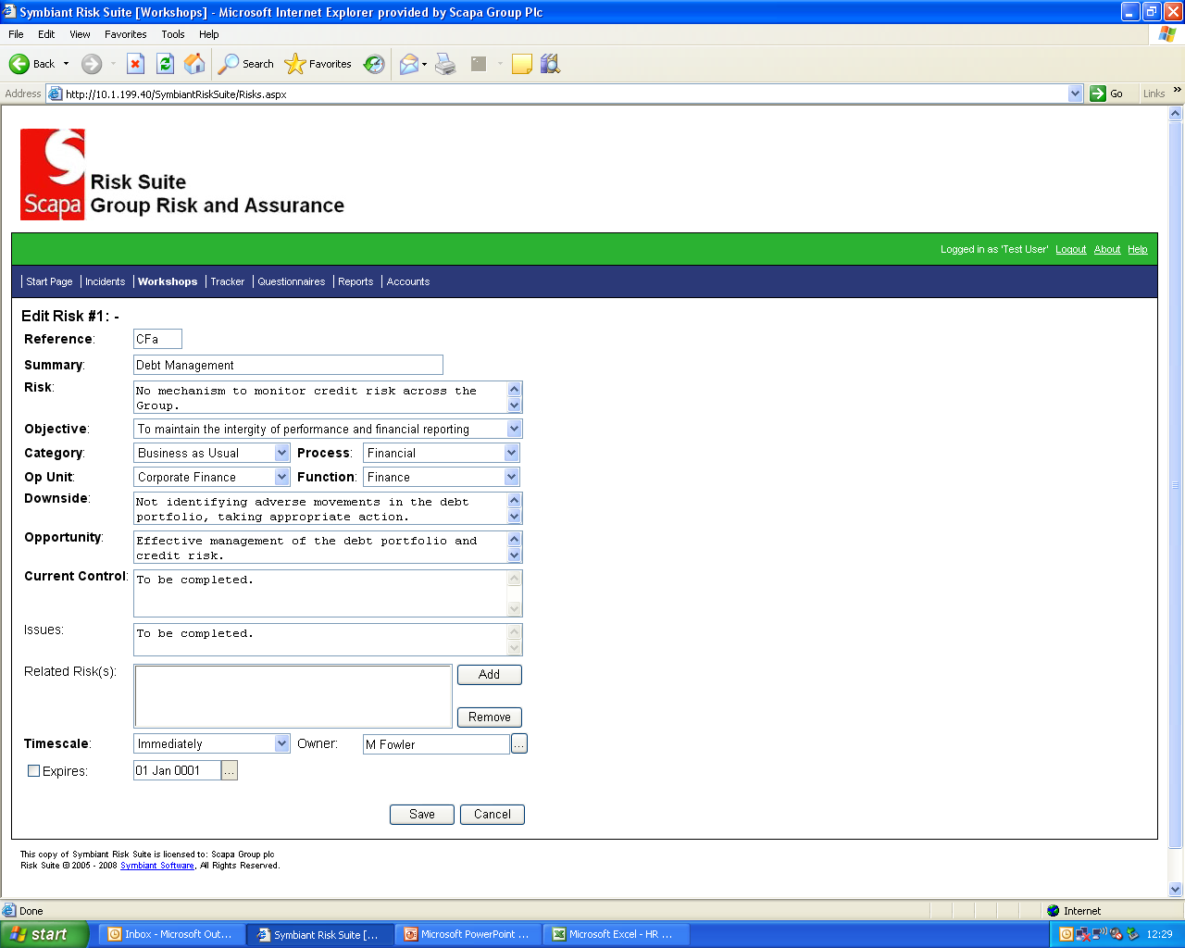
This screen shows the editable fields. Their description is self explanatory.
Some fields are pick list driven.
This field is used to assign risks to individuals. Only employees in the pick list should be added.
Changes must be saved.

Slide 10

To add or amend the risk scores click this icon. Icons with a tick already contain a risk score.

Slide 11
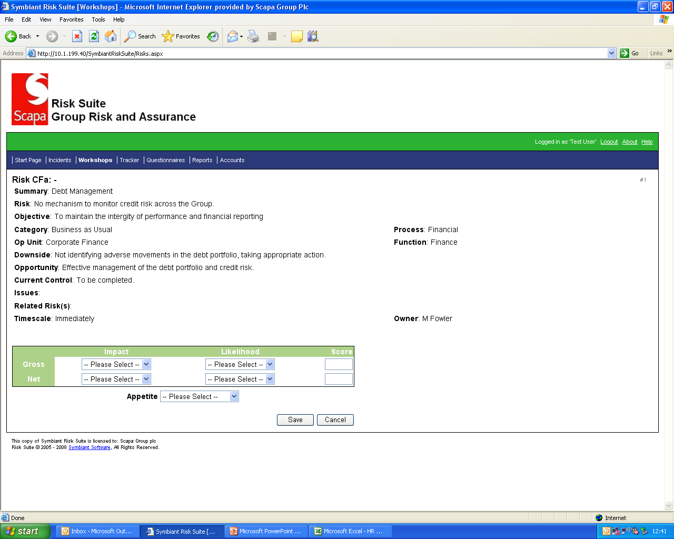
Use the pick lists to select the risk score and the Appetite based on the Residual Risk score.
Click on “Save” to save the changes.

Slide 12

To run or create a report, click on “Reports”.

Slide 13
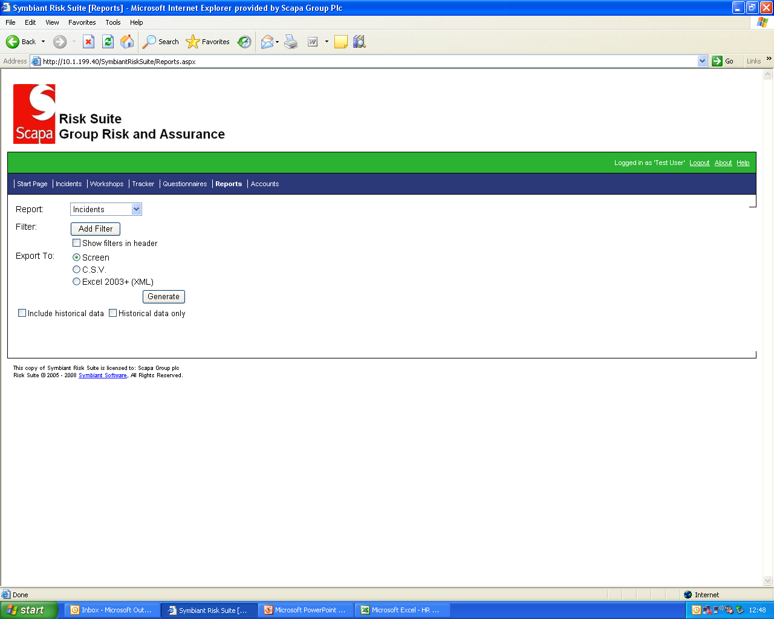
There are number of predefined reports under the heading of Workshops.
The Help facility provides a detailed explanation on reporting options, the following is a summary.

Slide 14
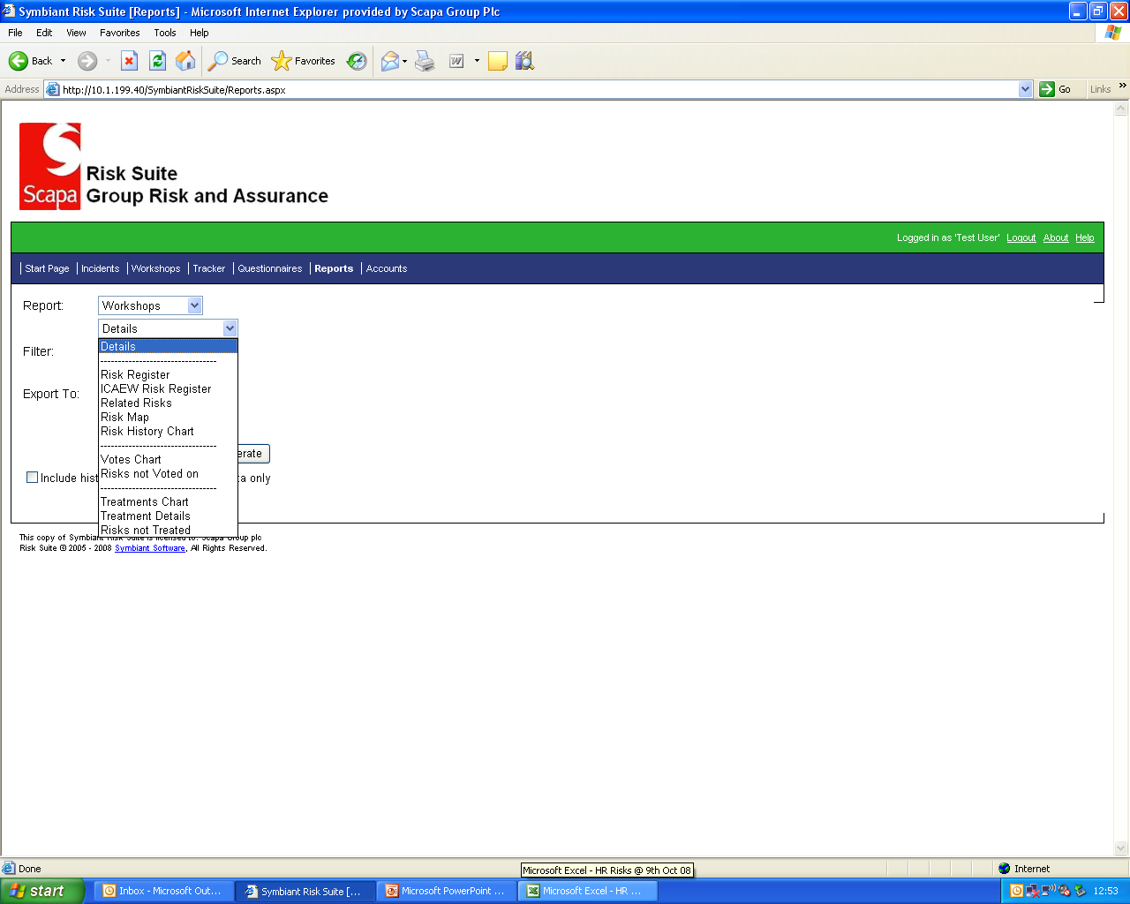
This example shows the standard reports.
These can be selected, and then further filters applied as follows.

Slide 15
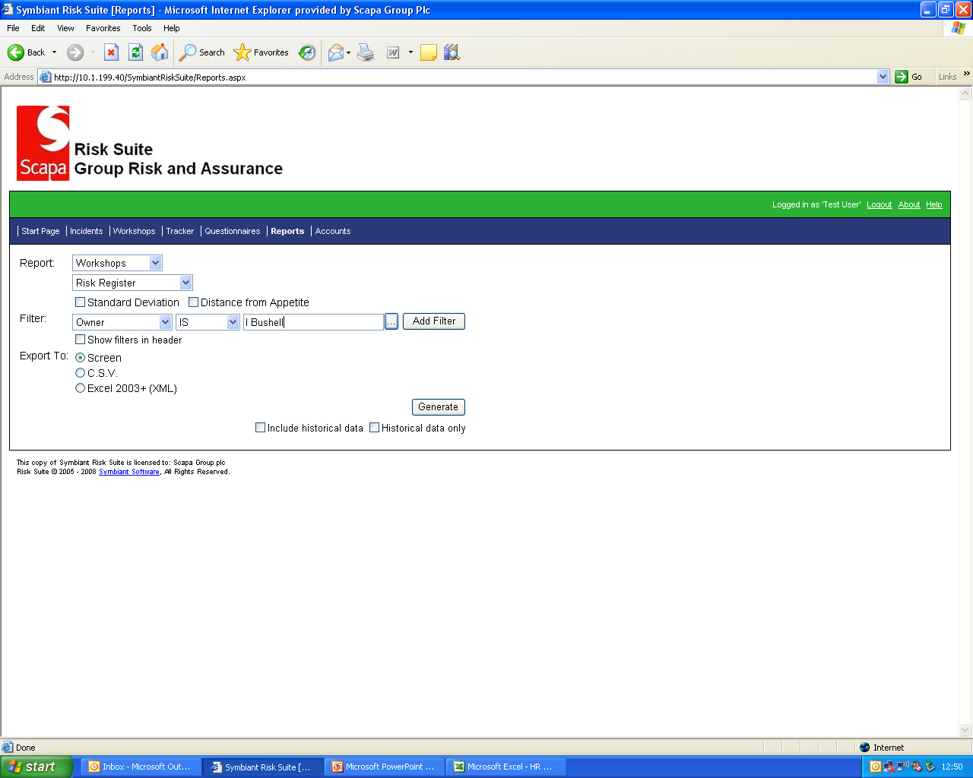
This example will produce a list of risks owned by the selected individual in the “filter”. Click on generate to produce a screen based report.

Slide 16
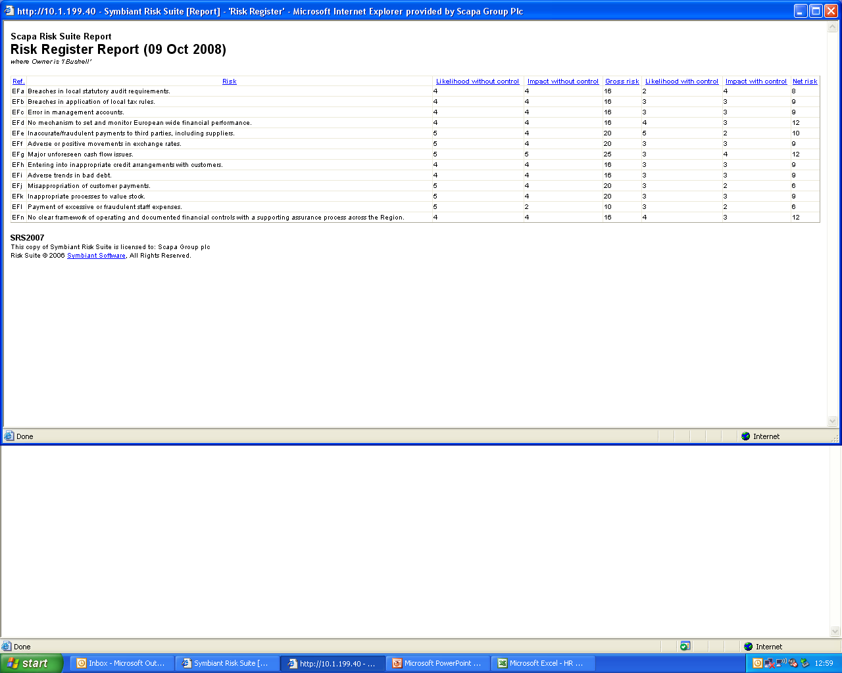
Data can be sorted by selecting the column heading.

Slide 17
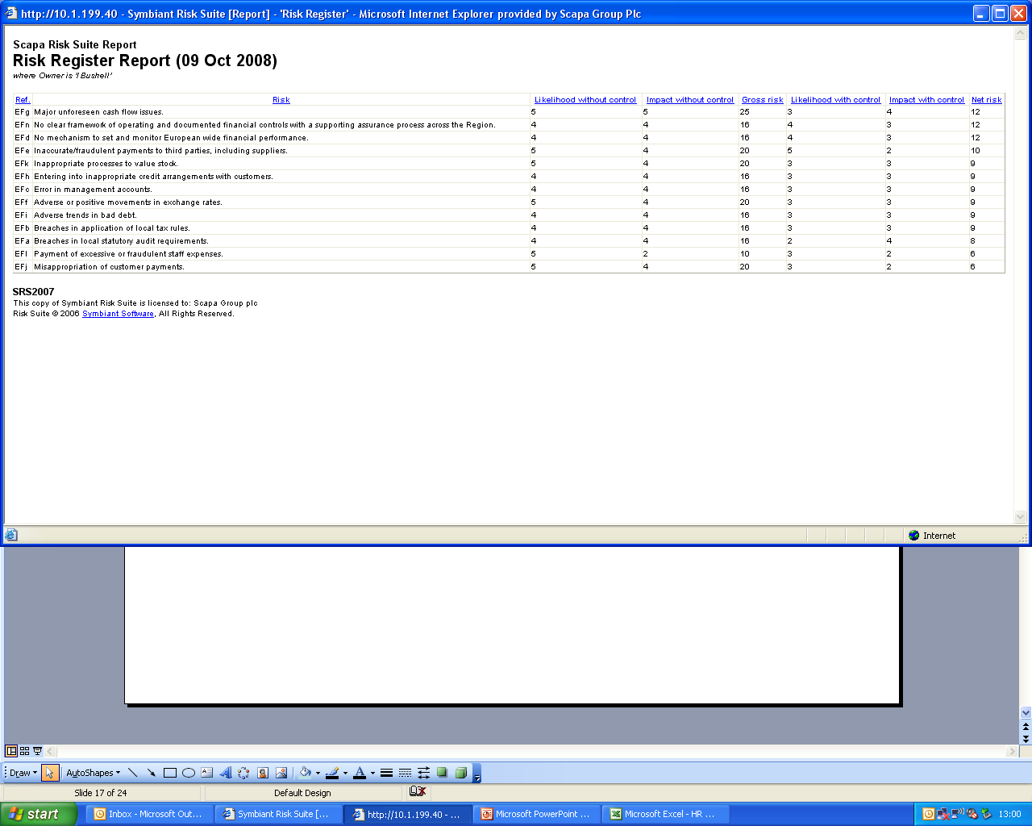
The data can be copies and pasted in Excel. Click here to close the window.
This shows the risks in a descending order of Residual Risk.

Slide 18
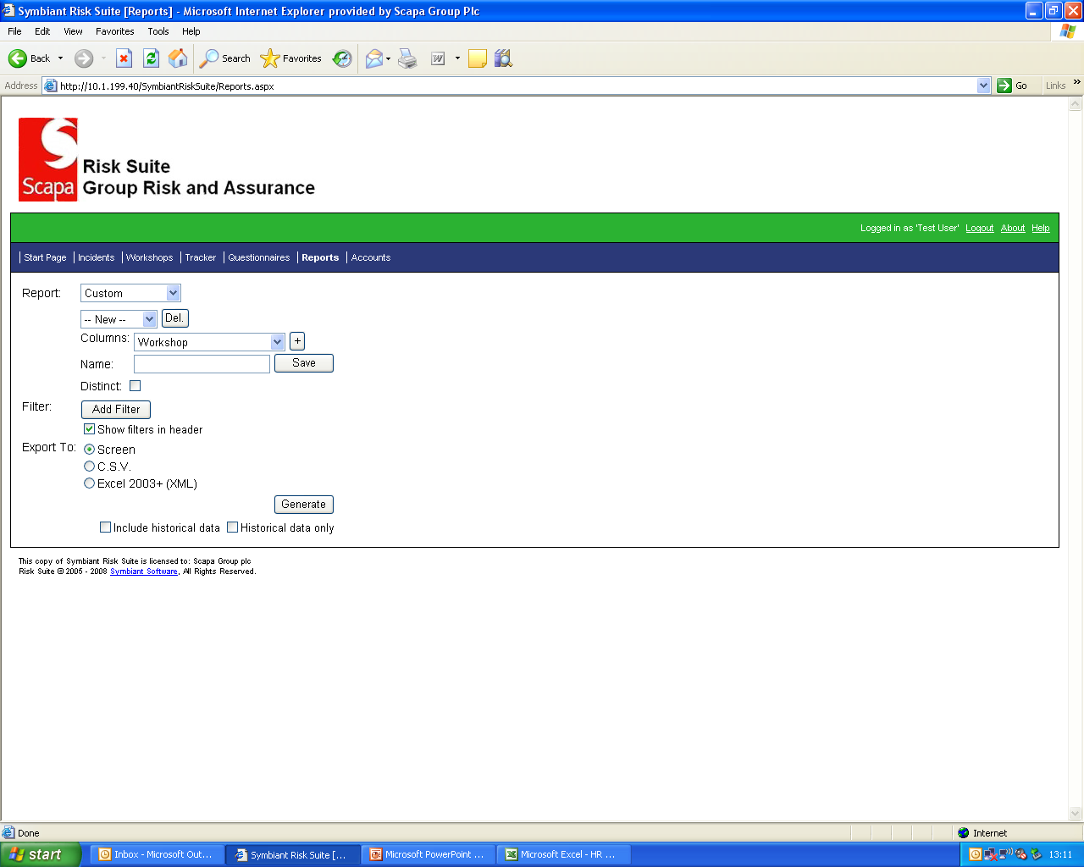
Custom reports can also be produced, by selecting from the pick list. These must be saved using a name with no gaps. You can select the data fields to export and the filters to apply.

Slide 19

All screens have a log out facility. Sessions are also timed out when no activity is detected after 10 minutes.

Slide 20
End of tutorial.

